Slide 1
Control Flow

Slide 2
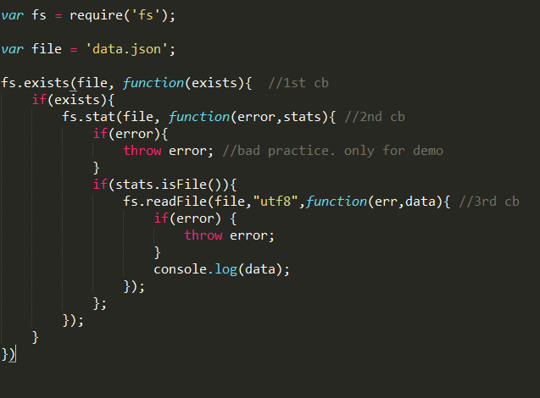
Control flow

Slide 3
Control Flow
Using many nested Callback leads to error prone
Controlling the many concurrent async operations very difficult.

Slide 4
Types of Control Flow
Sequential Execution
Parallel Execution
Limited Parallel Execution

Slide 5
Control Flow - Promises
Previously control Flow was achieved by libraries like async,
It was not part of ES5.
Recently, ES6 has introduced promise in native language.
Famous libraries supporting promises
Bluebird
Q
RSVP
Vow
When.js
es6-promise //library
Bluebird, Q are very popular ones. Provide more features.

Slide 6
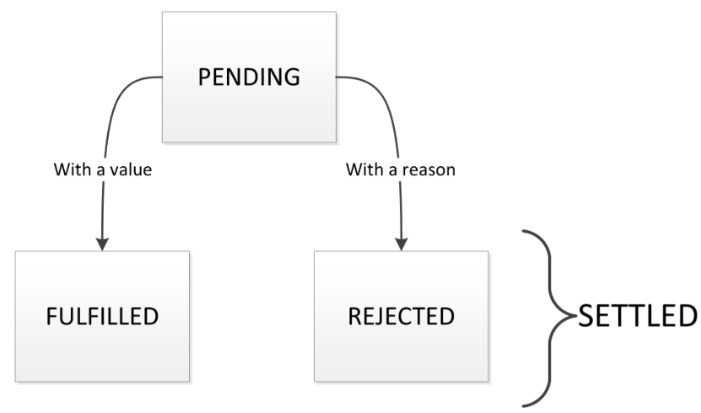
Promises – A+ specifications
Promise abstract object which represent the result/state of async operation
Promise object may be in three states
Pending
Fullfilled
Rejected
Promise are immutable

Slide 7
Promise – ES6 promise API
Constructor
new Promise(function(resolve,reject) {
//async operation
if(error) return reject(err);
//success
return resolve(obj);
});
Static Methods
Promise.resolve(value);
Promise.reject(err);
Promise.all(array_of_promises);
Instance Methods
Promise.then(onFulfilled , onRejected)
Promise.catch(onRejected)

Slide 8
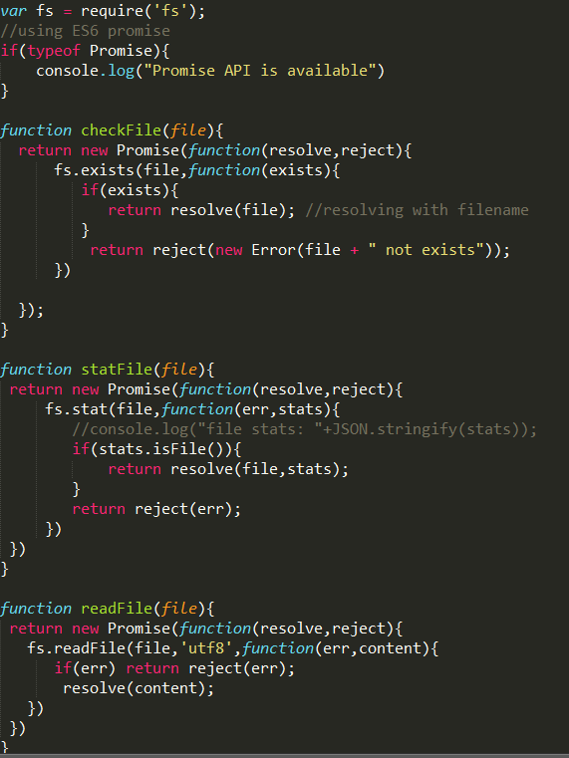
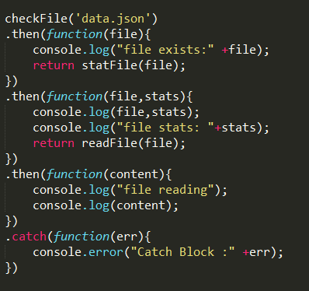

Slide 9
Chaining promise
You can chain the then’s by returning values
var promise = Promise.resolve(1);
promise
.then(function(val){
console.log(val) //1
return val + 1;
})
.then(function(val){
console.log(val) //2
});

Slide 10
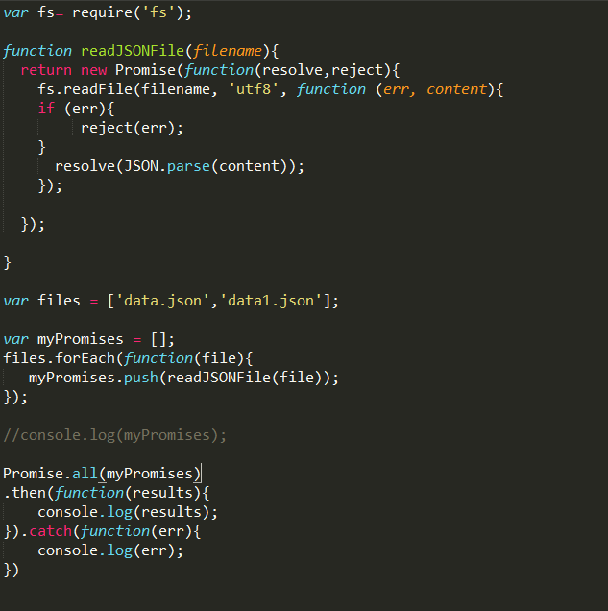
Parallel Execution
Promise.all waits for all fulfillments ( or the first rejection)

Slide 11
Bluebird – Promise library
Many features
Promisifying the existing callback based api ( like fs)
High control over asyn operation ( join, all, map )
http://bluebirdjs.com/docs/getting-started.html

Slide 12
Resources
https://www.promisejs.org/
https://developers.google.com/web/fundamentals/getting-started/primers/promises

